Slide 1
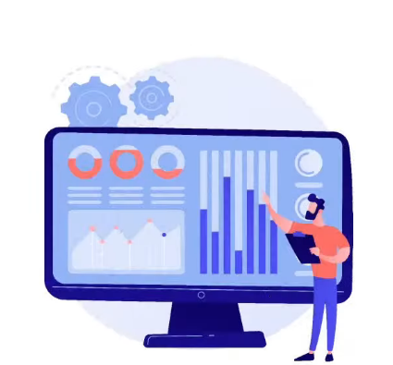
What is Data Analytics?

Slide 2
Agenda
Introduction to Data Analytics
Need of Data Analytics
Applications of Data Analytics
Data Analysts : Common Tasks
Data Analytics Life Cycle
Data Analytics : Job Roles
Introduction to Data Frames
How do you work with data frame?
Career in Data Analytics
Salary of a Data Analyst
Data Analyst : Key Skills
Data Analyst : Learning Path
Case Studies

Slide 3

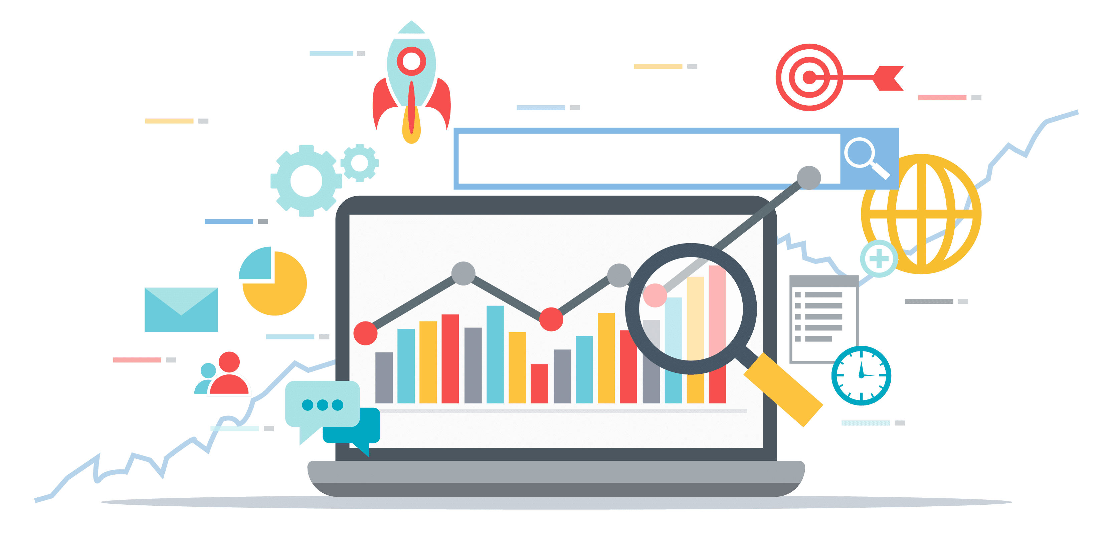
What is Data Analytics?
The pursuit of extracting meaning from raw data using specialized computer systems.
These systems transform, organize, and model the data to draw conclusions and identify patterns.
Today the field of data analytics is growing quickly, driven by intense market demand for systems that tolerate the intense requirements of big data, as well as people who have the skills needed for manipulating data queries and translating results.

Slide 4
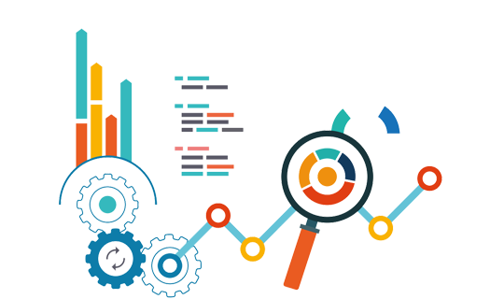
Need of Data Analytics
Data analytics demand is on the rise and soon, it will be an integral part of every organization
1
2
3
Data Analytics is now a priority for top organizations for effective decision making
To develop new revenue for every organization
To decrease the operation costs for every organizations

Slide 5
Applications of Data Analytics
Data Analytics has a wide range of applications across various industries. Here are some notable applications:
1
2
3
Healthcare
Finance
Transportation
4
5
6
Entertainment
Language Processing
Agriculture

Slide 6



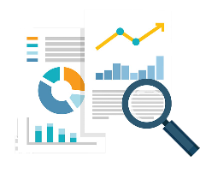
Who are Data Analysts?
Data Analysts deliver value to their companies by taking data, using it to answer questions, and communicating the results to help make business decisions
Common tasks done by data analysts include data cleaning, performing analysis and creating data visualizations
Business Analyst
Operations Analyst
Business Intelligence Analyst
Database Analyst

Slide 7





Data Analysts : Common Tasks
Cleaning and organizing raw unstructured data
Analysis of all hidden trends found in the data
Big-Picture view using descriptive statistics
Creating of dashboards and visualizations
Presentation of results to clients and internals

Slide 8
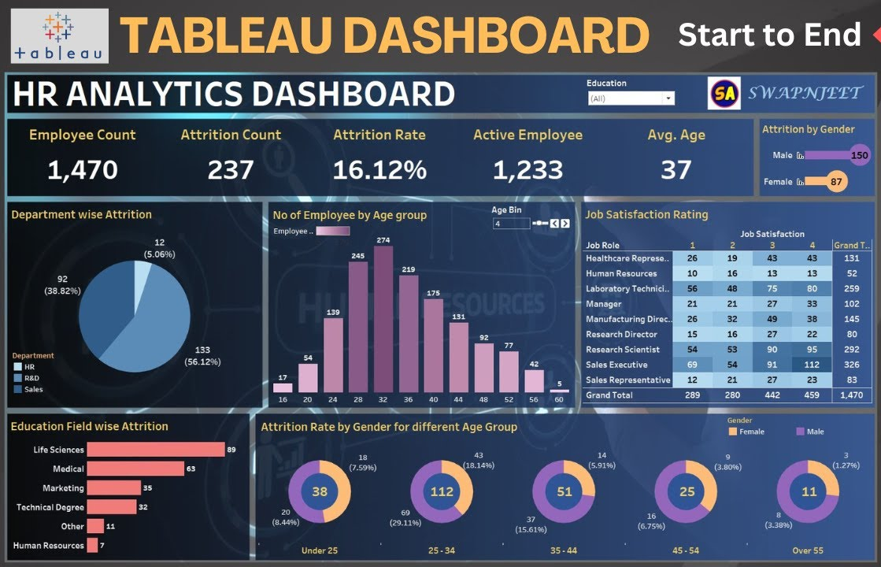

Slide 9

In a List
Data Engineer
Responsible for bringing in all the data from various sources
Data Analyst
Responsible for working on all of the raw data and convert it into valid information
Data Scientist
Responsible for developing machine learning models to solve business problems and improve processes.

Slide 10

Data Analytics Life Cycle

Slide 11
Data Analytics Lifecycle
Data Collection
Decision Making
Data Preprocessing
Model Evaluation
Data Modeling
Model Building

Slide 12
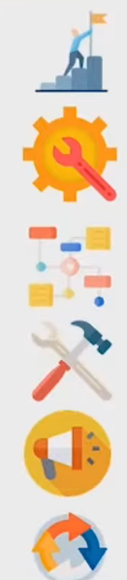
Data Analytics Lifecycle
Data Collection
Data Preprocessing
Data Modeling
Model Building
Model Evaluation
Decision Making

Slide 13

Data Analytics Job Roles

Slide 14

Data Analytics: Job Roles
Different Roles Required
Data Analyst
Business Analyst
Data Engineer
Data Architect
Database Manager
Marketing Analyst

Slide 15
What is DataFrame?
A DataFrame is a fundamental data structure used in data manipulation and analysis using Pandas library.
DataFrames are commonly used for working with structured data, such as data from CSV files, databases, or Excel spreadsheets.
DataFrames are widely used in data analysis, data cleaning, data transformation, and statistical analysis.
They provide a flexible and efficient way to work with structured data, making them a crucial component in data science and analytics workflows.

Slide 16
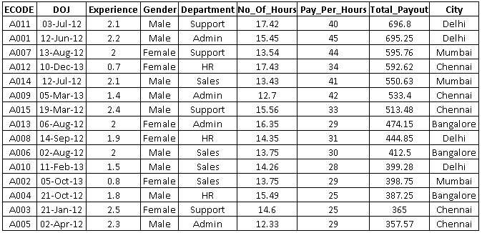
DataFrame

Slide 17

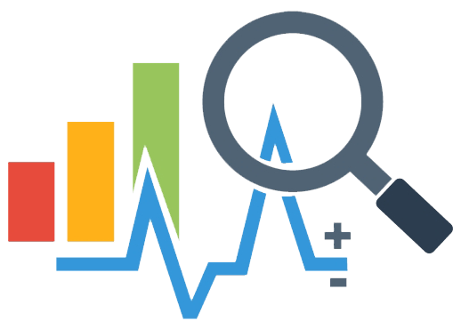
Career in Data Analytics

Slide 18

Trends:
Data Analytics

Slide 19
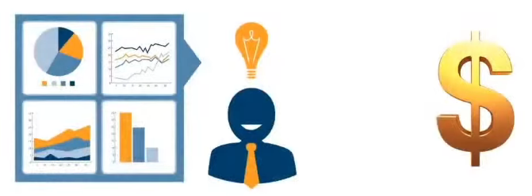
Trends: Data Analytics
Business Intelligence is MANDATORY for commercial success

Slide 20
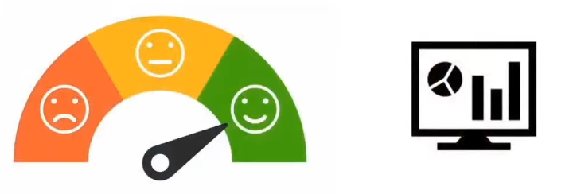
Trends: Data Analytics
Competitive Customer Satisfaction is driven by analytics

Slide 21
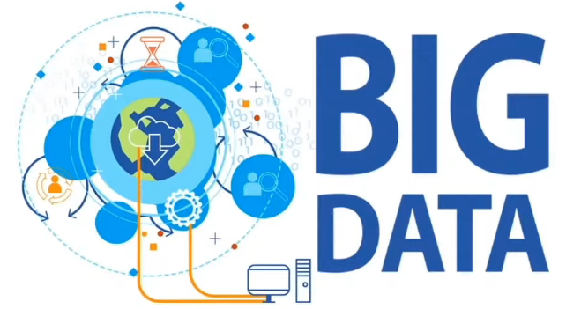
Trends: Data Analytics
Large Amounts of rapidly and continuously generated Data warrant Big Data Analytics

Slide 22


Trends: Data Analytics
The usage of AI/ML to derive faster and more efficient insights from Data

Slide 23

Data Analyst:
Salary

Slide 24
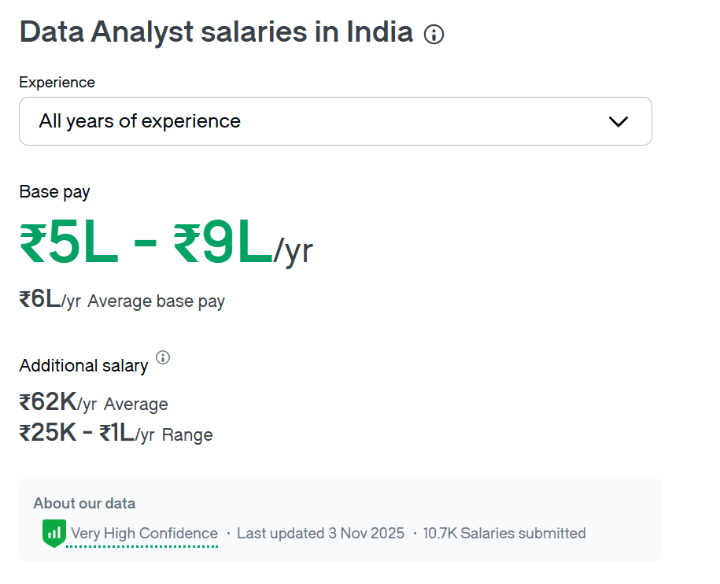


Slide 25
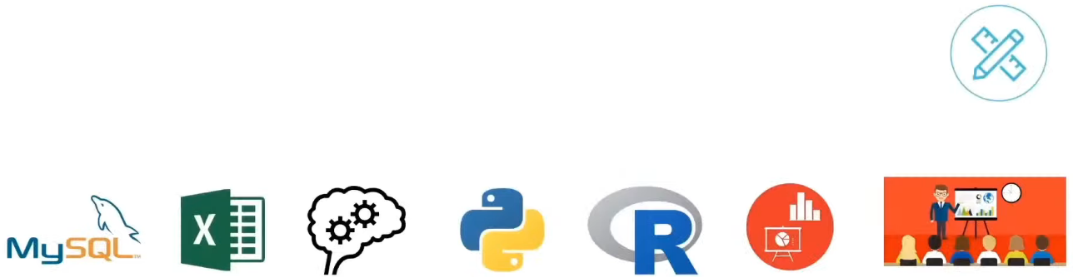
Data Analyst: Key Skills
Critical Thinking
Data Visualization
Presentation Skills

Slide 26
Data Analyst:
Learning Path

Slide 27
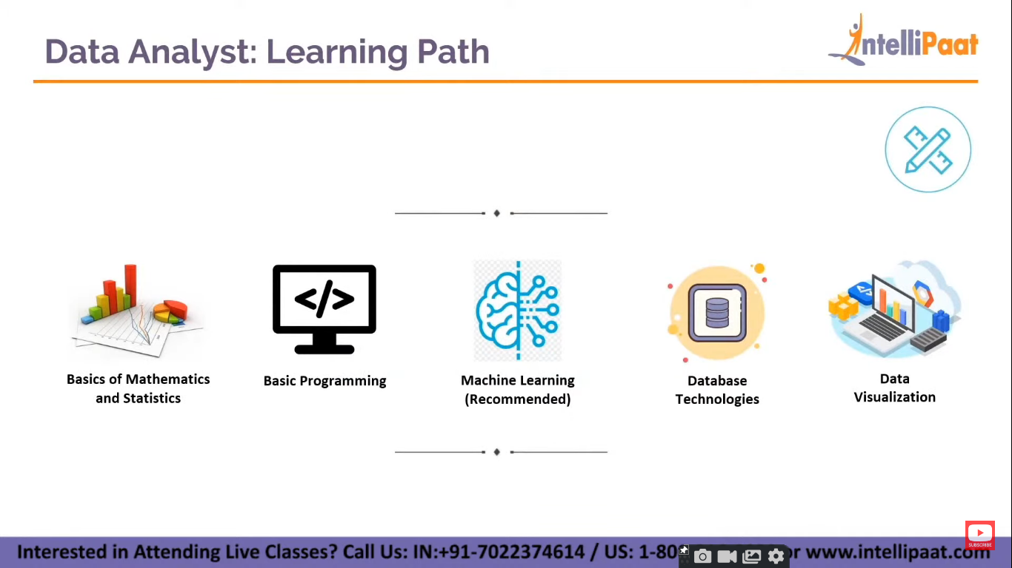
Data Analyst: Learning Path
Basics of Mathematics and Statistics
Basic Programming
Machine Learning
(Recommended)
Database Technologies
Data Visualization

Slide 28
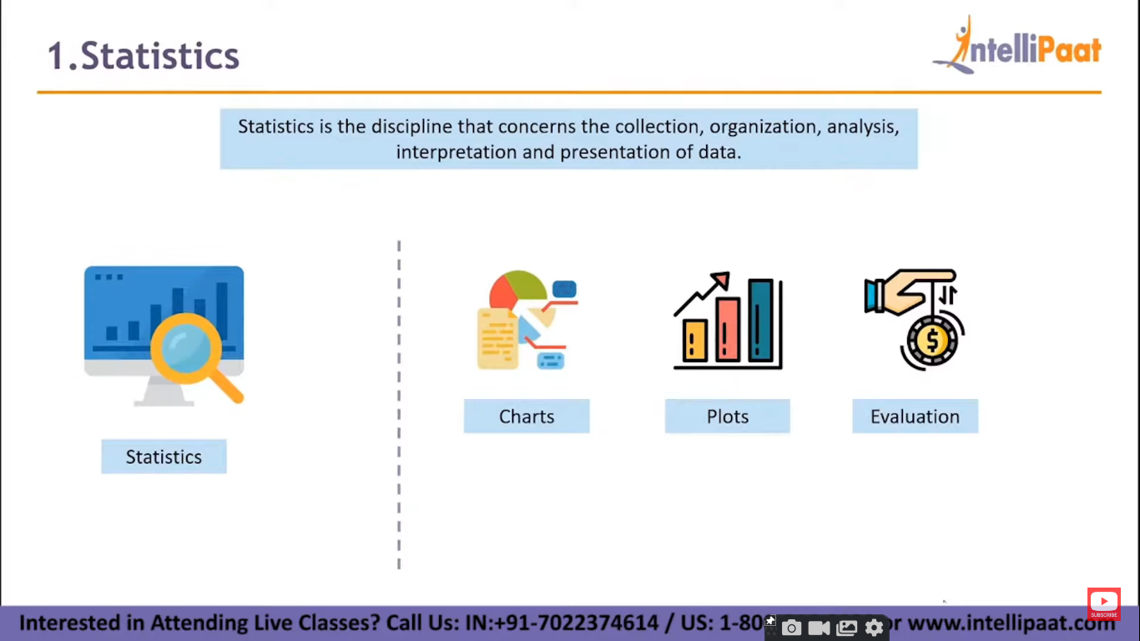
1. Statistics
Statistics is the discipline that concerns the collection, organization, analysis, interpretation and presentation of data.
Charts
Plots
Evaluation
Statistics

Slide 29
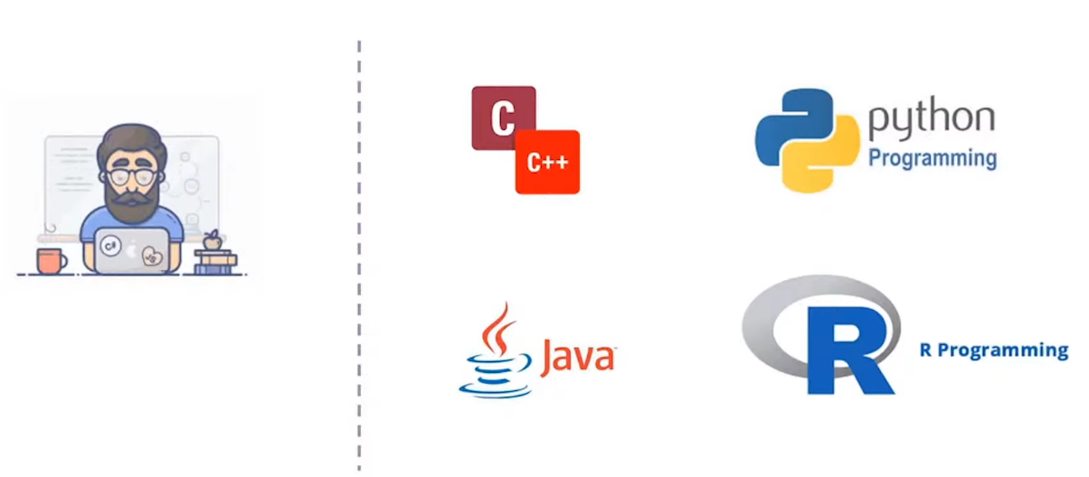
2. Programming Language

Slide 30
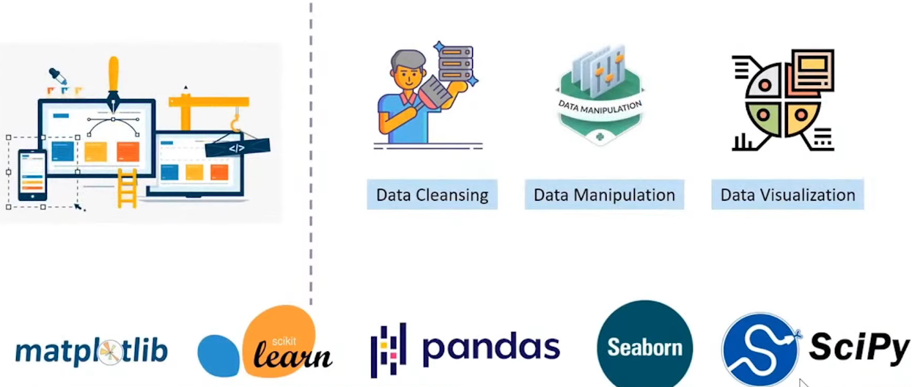
3. Data Cleansing, Manipulation, & Visualization

Slide 31
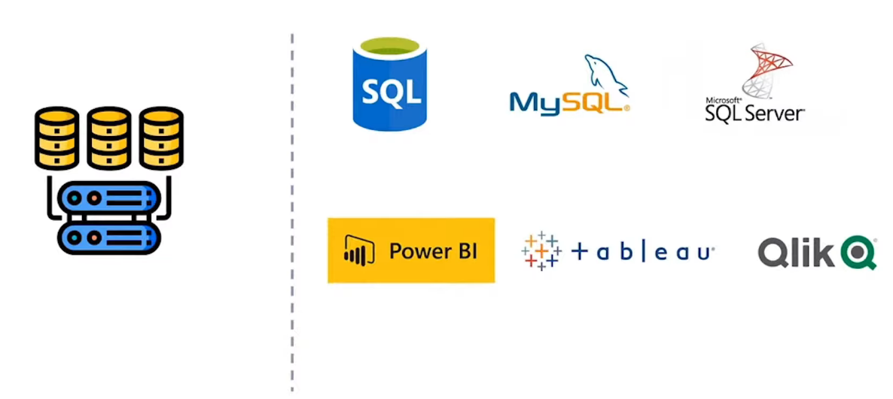
4. Database and BI Tools

Slide 32
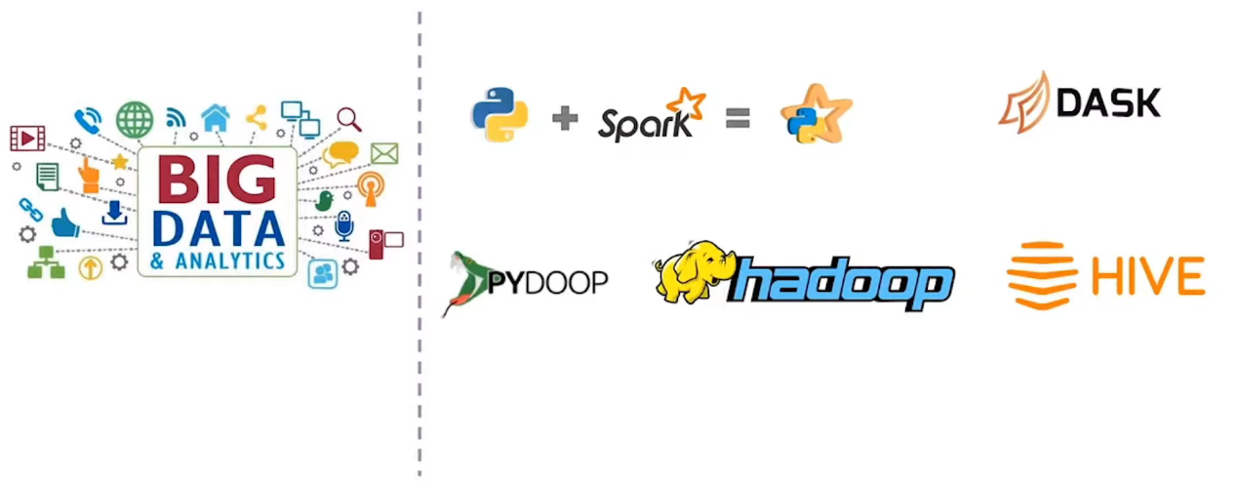
5. Big Data

Slide 33
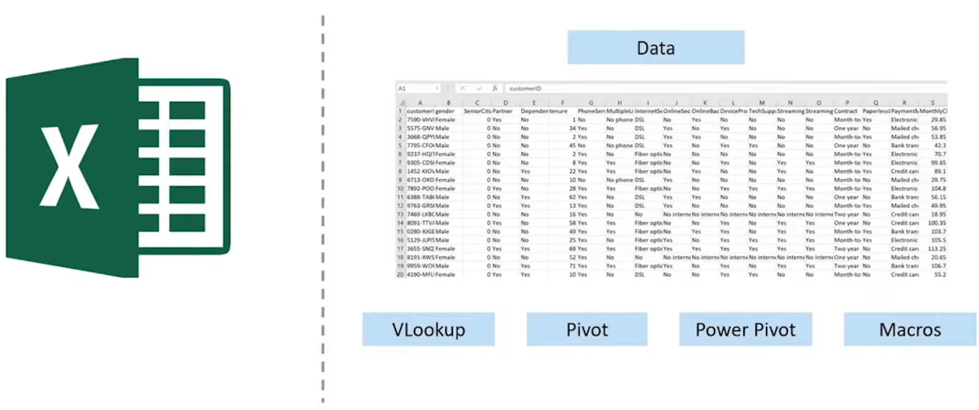
6. Excel

Slide 34
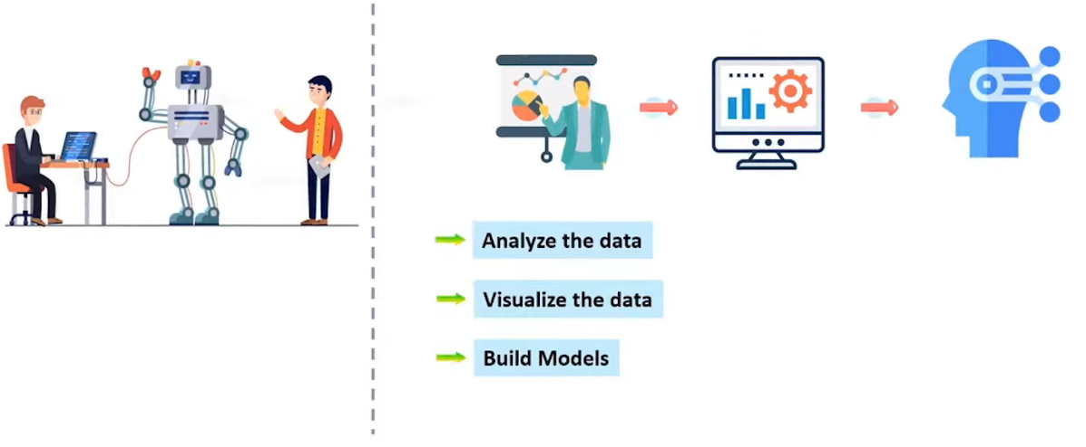
7. Machine Learning

Slide 35
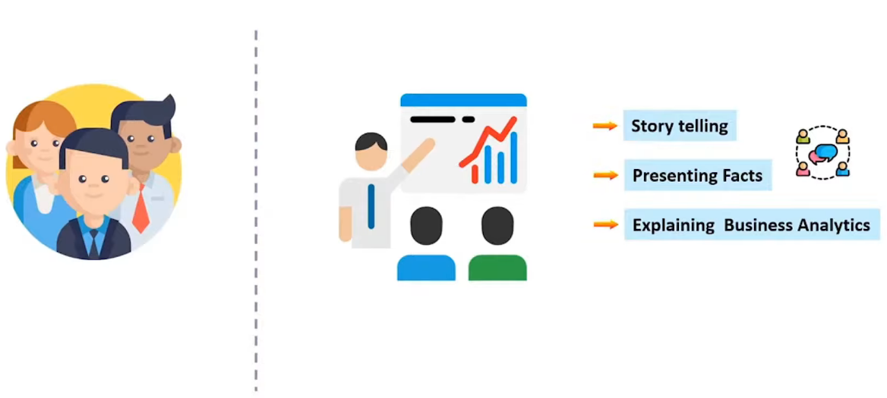
8. Communication Skills

Slide 36
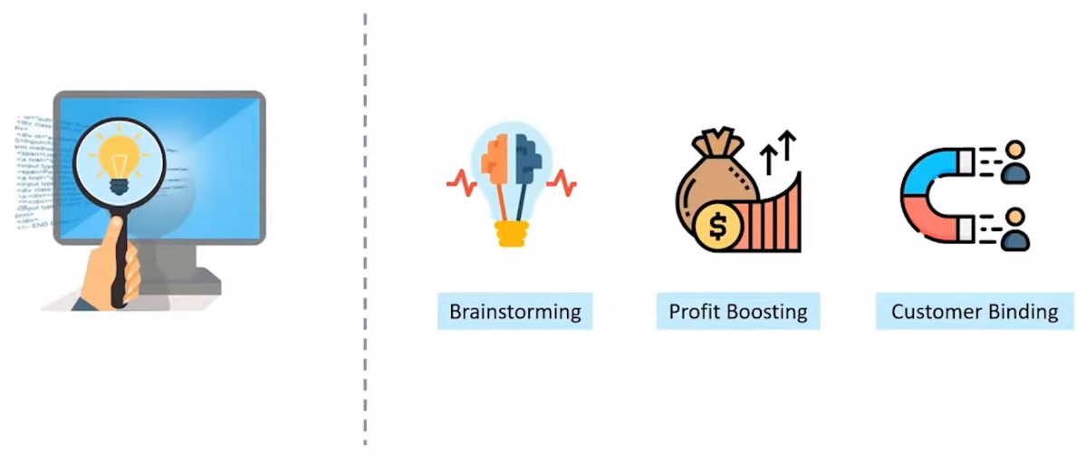
9. Creative & Critical Thinking

Slide 37



10. Business/Domain Knowledge

Slide 38
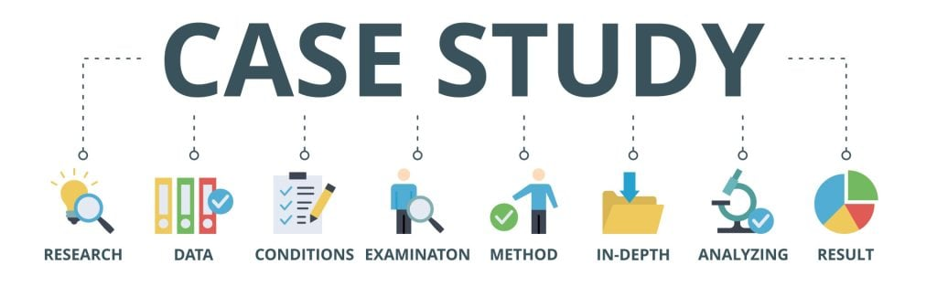

Slide 39
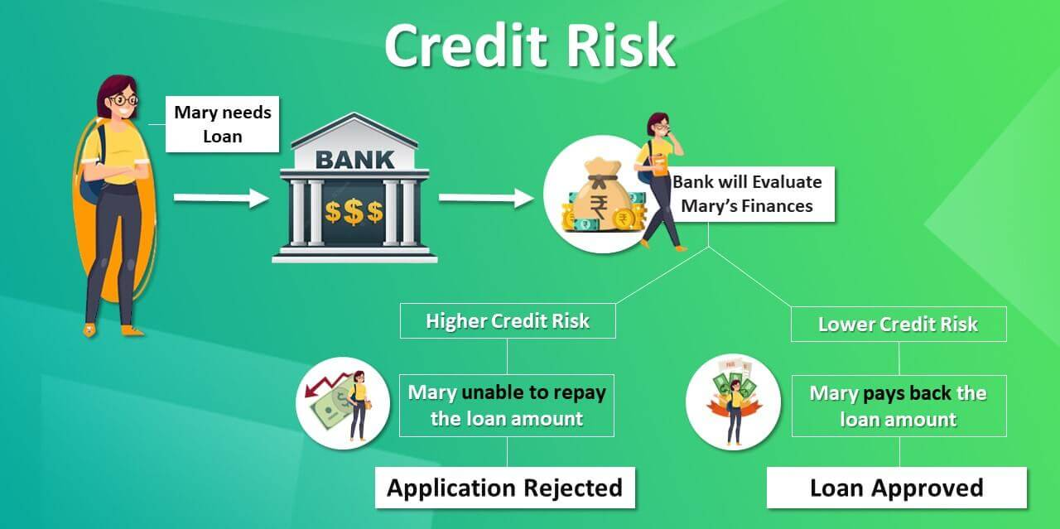
Credit Risk Modeling

Slide 40
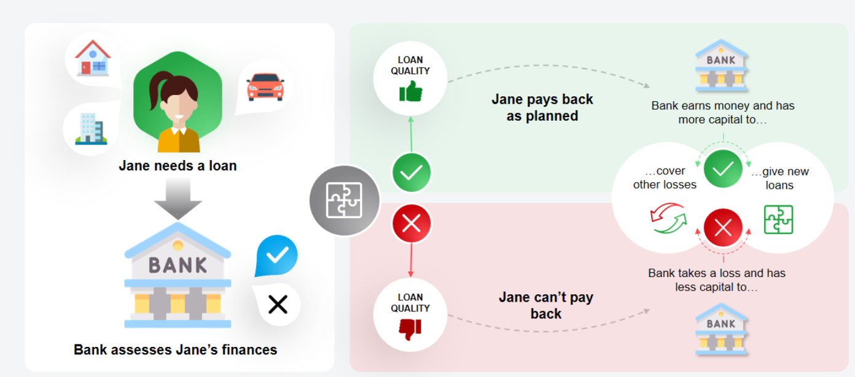
Credit Risk Modeling

Slide 41


